Slide 1

(MR23-1CS0106) UI Frameworks

Slide 2
UNIT –V:
Node Installations
Understanding Express framework
Working with routes

Slide 3
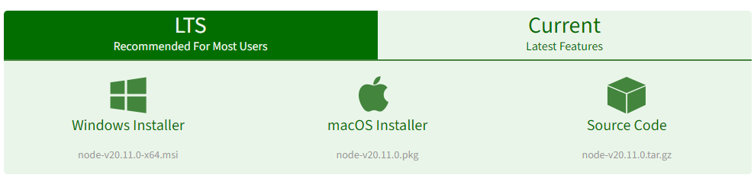
Node Installation
Step 1:
Download the Node.js source code or a pre-built installer for your platform using the following link:
Here install the LTS version (the one present on the left). Once downloaded open NodeJS without disturbing other settings, click on the Next button until it’s completely installed.
https://nodejs.org/en/download/
Note: click on windows Installer. The software will be downloaded on your device.

Slide 4
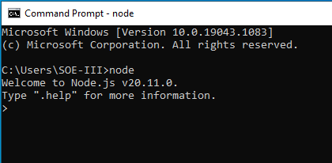
Node Installation
Step 2:Open command prompt to check whether it is completely installed or not, type the command –> node
Note: If the installation is done properly, it will give you the version you have installed.

Slide 5
Understanding Express framework
Express is a fast, assertive, essential and moderate framework for Node.js.
You can assume express as a layer built on the top of the Node.js that helps manage a server and routes.
It provides a robust set of features to develop web and mobile applications.
It can be used to design single-page, multi-page and hybrid web applications.

Slide 6
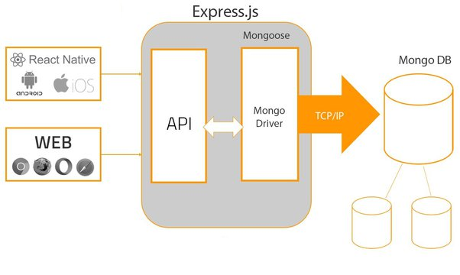

Slide 7
It allows to setup middlewares to respond to HTTP Requests.
It defines a routing table which is used to perform different actions based on HTTP method and URL.
It allows to dynamically render HTML Pages based on passing arguments to templates.
Use of Express
Ultra fast I/O
Asynchronous and single threaded
MVC like structure
Robust API makes routing easy

Slide 8
Installation of Express
Open visual studio -> choose the path (angular or react)-C:\Users\SOEIII\myapp\node_modules\express (select express folder)
Step 1:check version of node and npm using
node --version
npm --version
Step 2: To continuously change/update code- and auto monitor/reload it
npm i nodemon
Step 3:initialize the npm using below commands
npm init
Step 4:Install express using below command
npm install express (or) npm i express

Slide 9

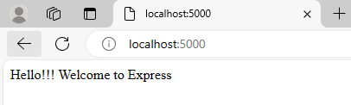
Express – Example code
Run the code using
node .\index.js in terminal
Step 4:Create index.js file and write the code
const express = require ("express")
const app = express ();
app.get("/", (req,res) => {
res.send("Hello!!! Welcome to Express ")
});
app.listen(5000);

Slide 10
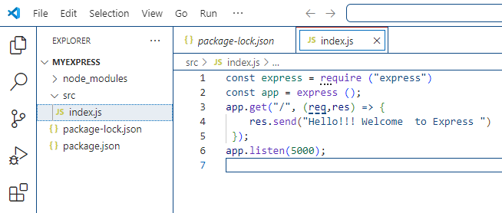

Slide 11
Express – Example code- Explanation of each step
var express =require("express"):
Importing express js module into our application
var app=express():
Initiating the app using express
Using the app we are configuring the route of home page and path
is “/” (Home page)
Whenever there is a request from the endpoint(/)- “Hello!!! Welcome to Express” will be displayed.
app.get ("/",(req,res)=>{ res.send(“Hello!!! Welcome to Express")
)}:
Req is a input-HTTP Request
Res is a output –HTTP Response
app.listen (5000):
Output Port address

Slide 12
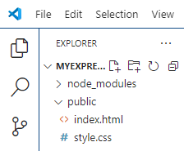
Serving HTML and CSS files in Express
Navigate to the express folder and create a new folder with name “public”
In the “public” folder create the following files
index.html
style.css
index.html file:
<!DOCTYPE html>
<header>
<link rel="stylesheet" href="style.css"
</header>
<h1>Welcome to HTML Page</h1>
<ul>
<li>REACT</li>
<li>ANGULAR</li>
<li>EXPRESS</li>
</ul>
</html>
style.css file:
h1{color:red;}
ul{color: blue;}

Slide 13
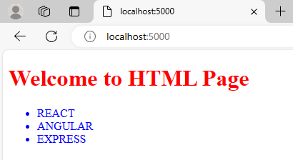
Serving HTML and CSS files in Express
3. Write the following code in the index.js file
index.js file:
const express = require ("express")
const app = express ();
const path = require("path");
const staticpath=path.join(__dirname, "../public");
app.use(express.static(staticpath));
app.listen(5000);

Slide 14
Routing
Routing refers to how an application’s endpoints (URIs) respond to client requests. Routing is defined using methods of the Express app object that correspond to HTTP methods,
For example:
app.get() to handle GET requests
app.post to handle POST requests
app.all() to handle all HTTP methods and
app.use() to specify middleware as the callback function
These routing methods specify a callback function (sometimes called “handler functions”) called when the application receives a request to the specified route (endpoint) and HTTP method. In other words, the application “listens” for requests that match the specified route(s) and method(s), and when it detects a match, it calls the specified callback function.

Slide 15
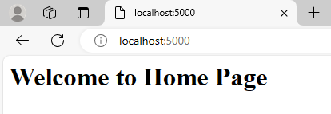
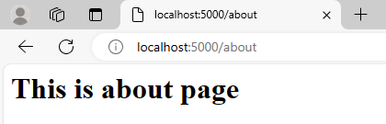
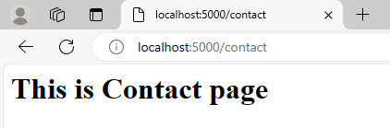
Creating Routes
const express = require ("express")
const app = express ();
app.get("/", (req,res) => {
res.send("Welcome to Home Page ")
});
app.get("/about", (req,res) => {
res.send("This is about page ")
});
app.get("/Contact", (req,res) => {
res.send("This is Contact page ")
});
app.listen(5000);
Home Page:
About Page:
Contact Page:
Notes:
const express = require ("express")
const app = express ();
app.get("/", (req,res) => {
res.send("Welcome to Home Page ")
});
app.get("/about", (req,res) => {
res.send("This is about page ")
});
app.get("/Contact", (req,res) => {
res.send("This is Contact page ")
});
app.listen(5000);

Slide 16
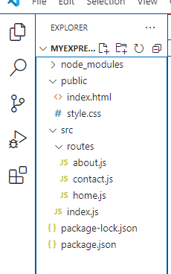
Express Router
Create a folder and name it as ‘routes’ in the express app folder
Create the following files in the ‘routes’ folder:
Home.js
About.js
Contact.js
3. Provide the paths in the index.js file

Slide 17
Express Router
home.js File:
const express = require ("express")
const router = express.Router();
router.get('/', (req,res)=> {
res.send("this is home page")
})
module.exports=router;
about.js File:
const express = require ("express")
const router = express.Router();
router.get('/', (req,res)=> {
res.send("this is about page")
})
module.exports=router;
contact.js File:
const express = require ("express")
const router = express.Router();
router.get('/', (req,res)=> {
res.send("this is contact page")
})
module.exports=router;

Slide 18
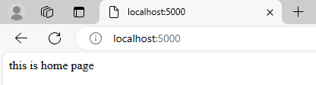
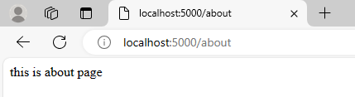
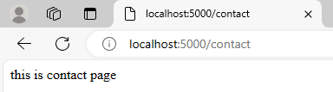
Express Router
index.js file:
const express = require ("express")
const app = express ();
const home=require('./routes/home')
const about=require('./routes/about')
const contact=require('./routes/contact')
app.use('/',home)
app.use('/about',about)
app.use('/contact',contact)
app.listen(5000);

Slide 19
THANK YOU

